Slide 1

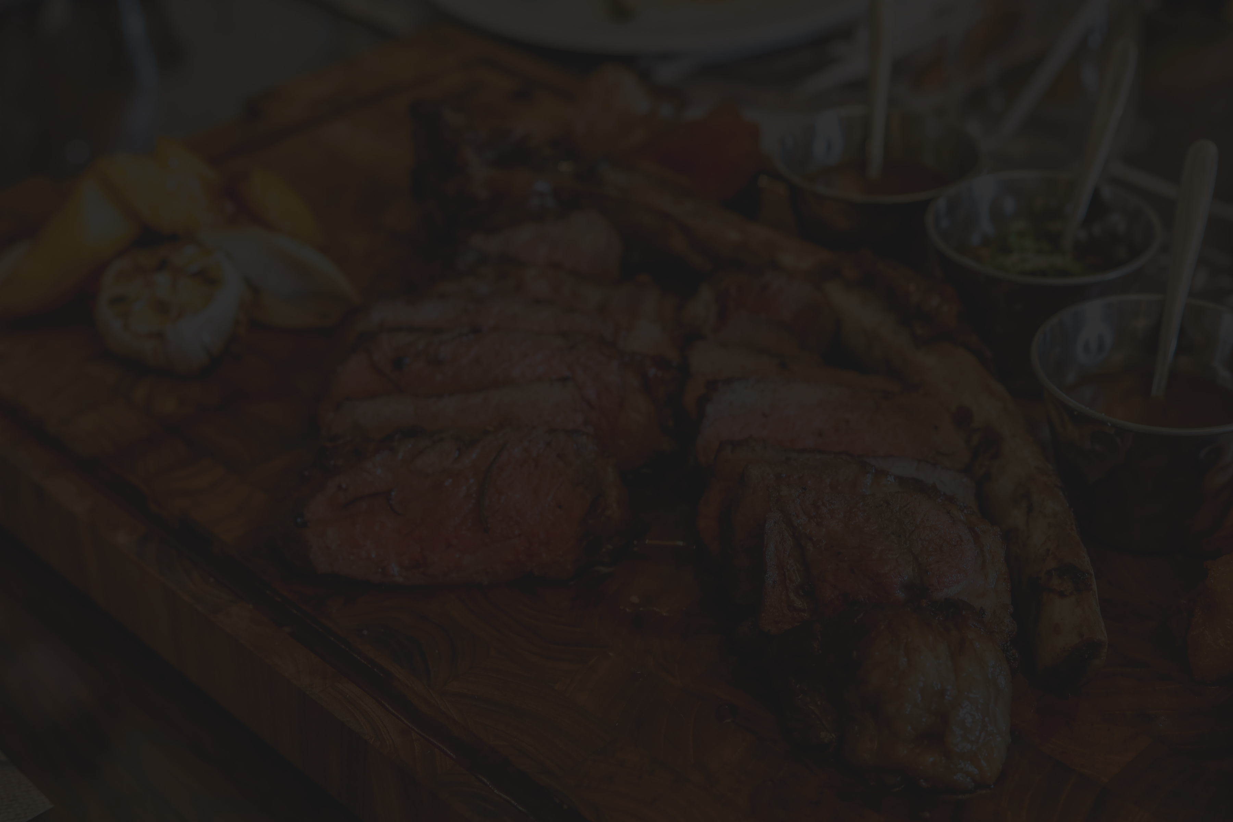


Group 3T Project
Welcome to TTT
The Restaurant Management Website

Slide 2
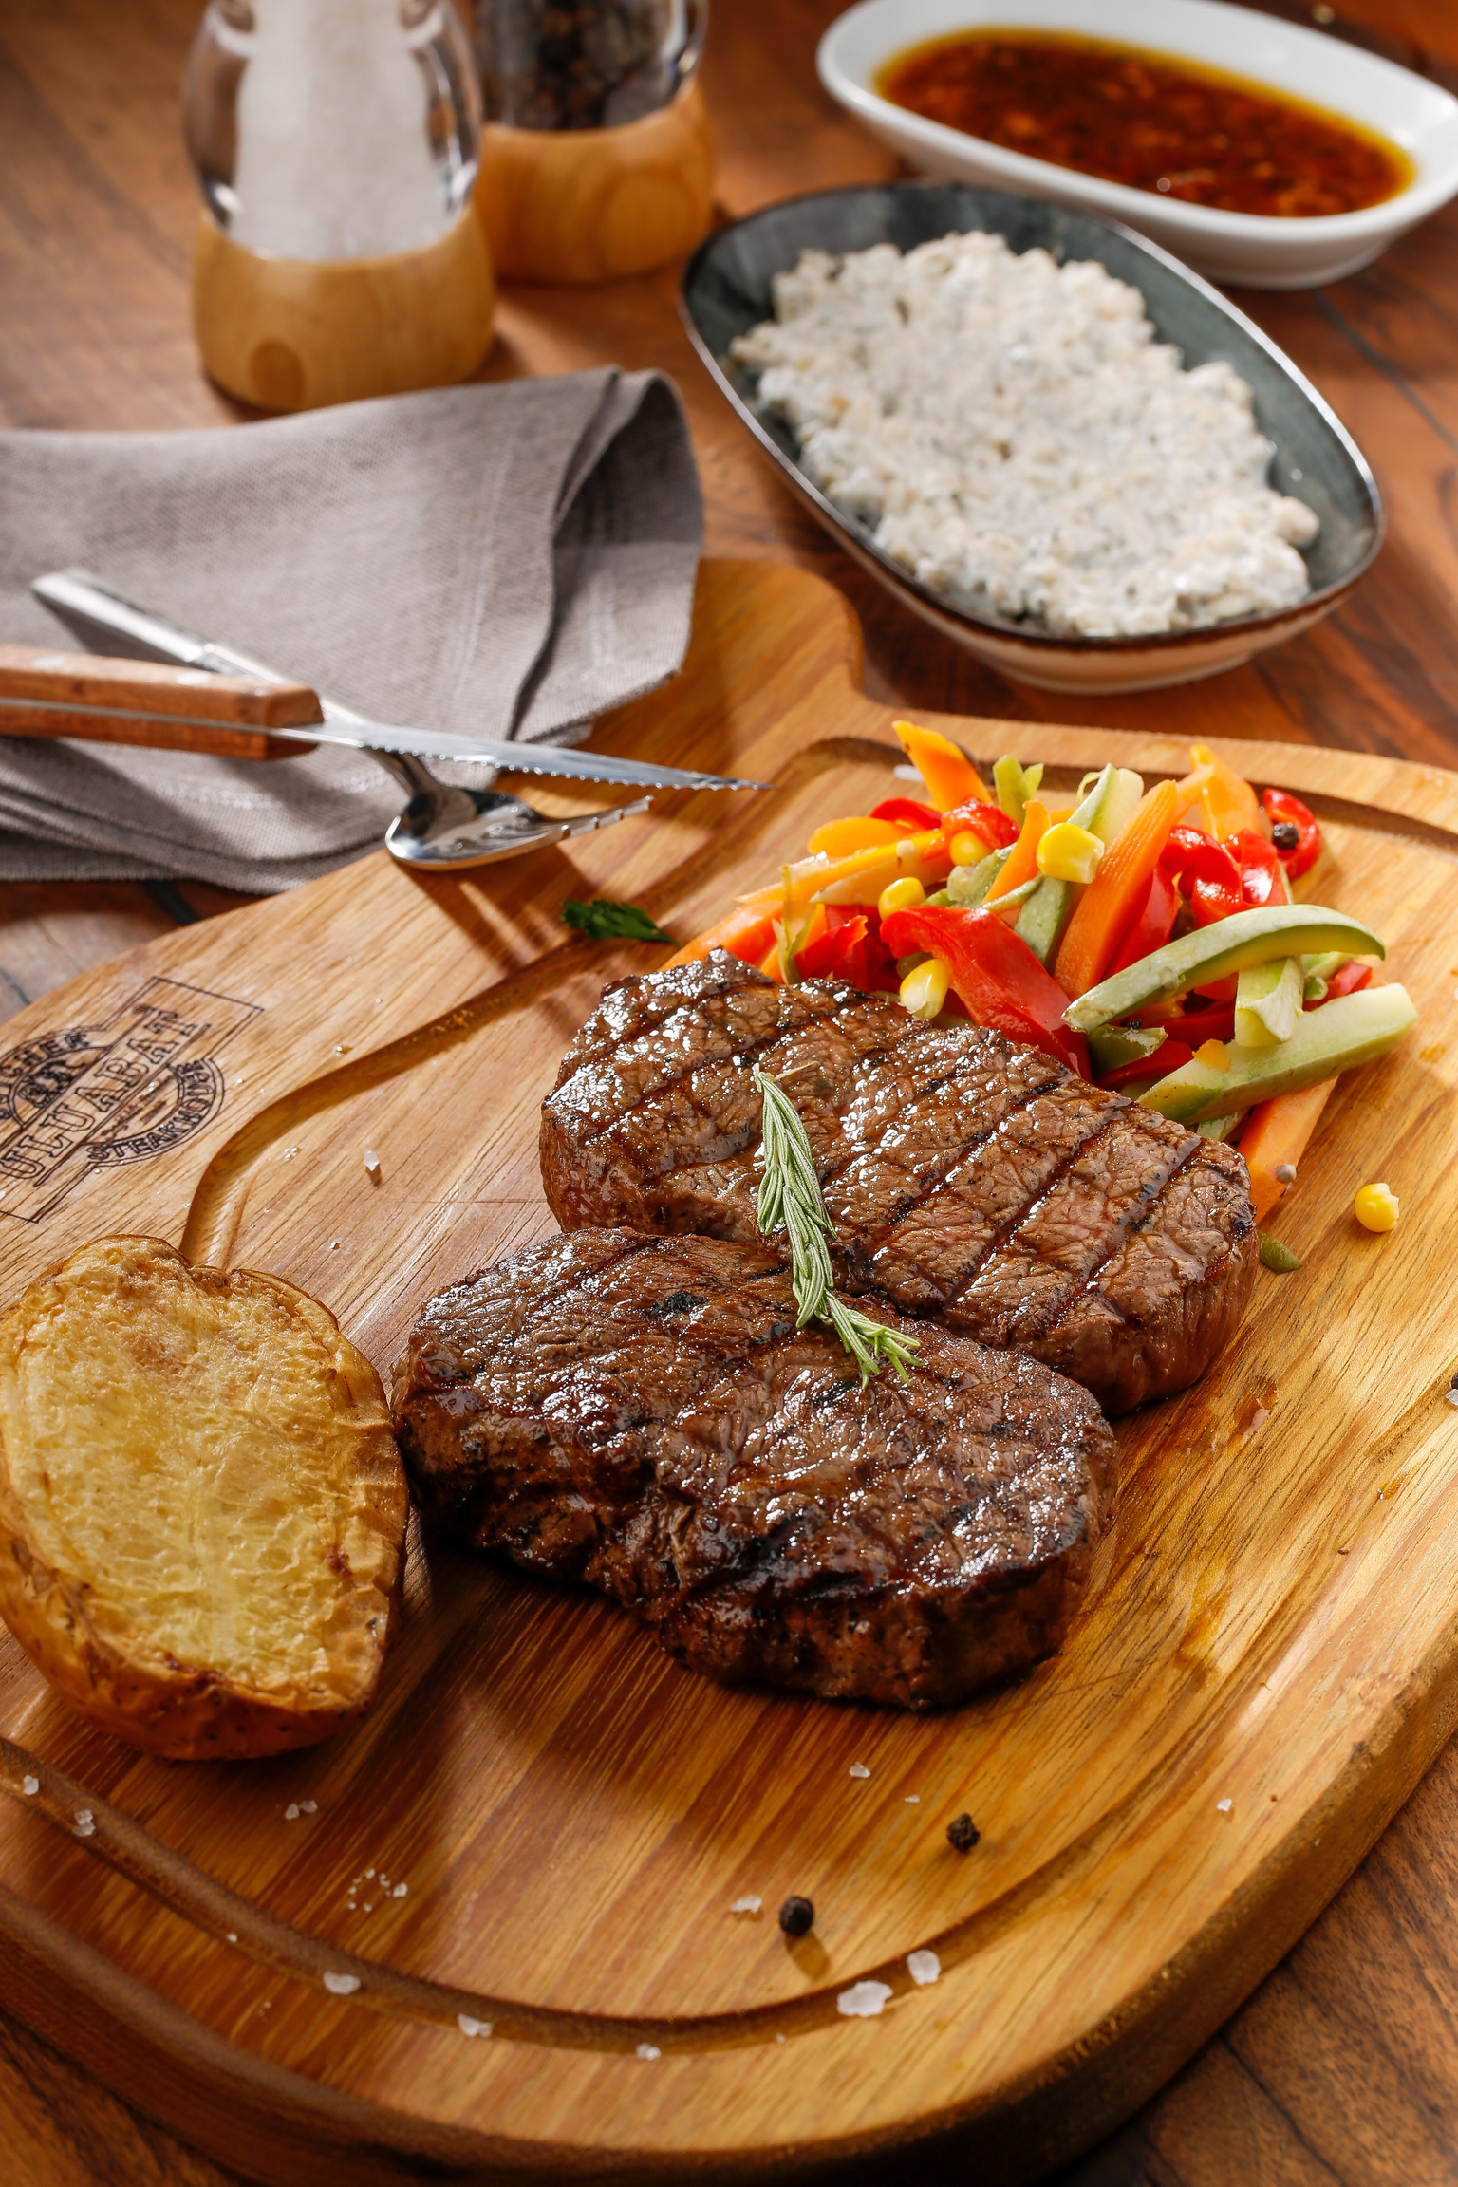
Team introduction
Đỗ Gia Thụy - ITCSIU21237
Nguyễn Thanh Tú - ITITIU21338
Dương Minh Tuấn - ITITWE21092
LEARN MORE

Slide 3
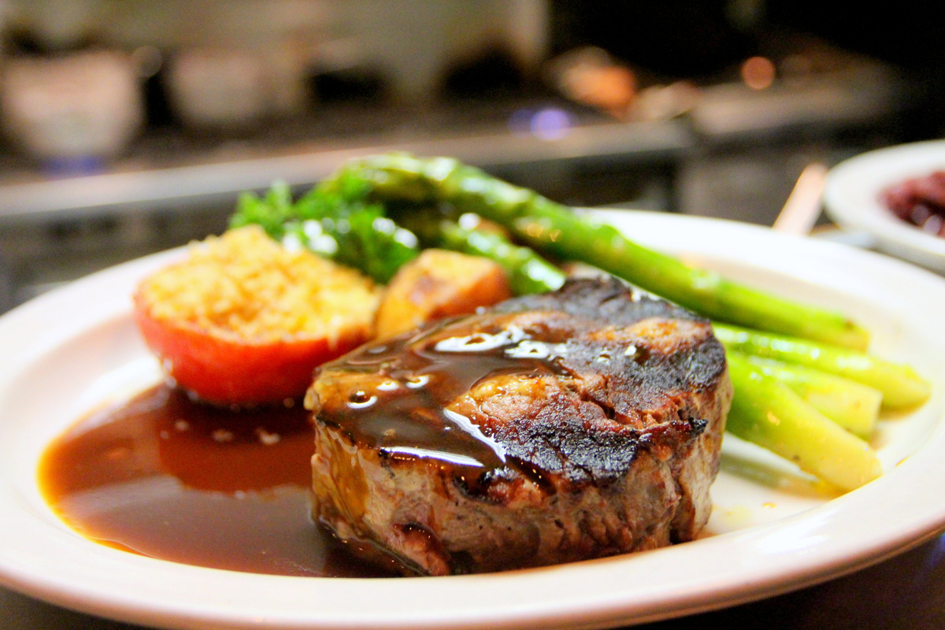
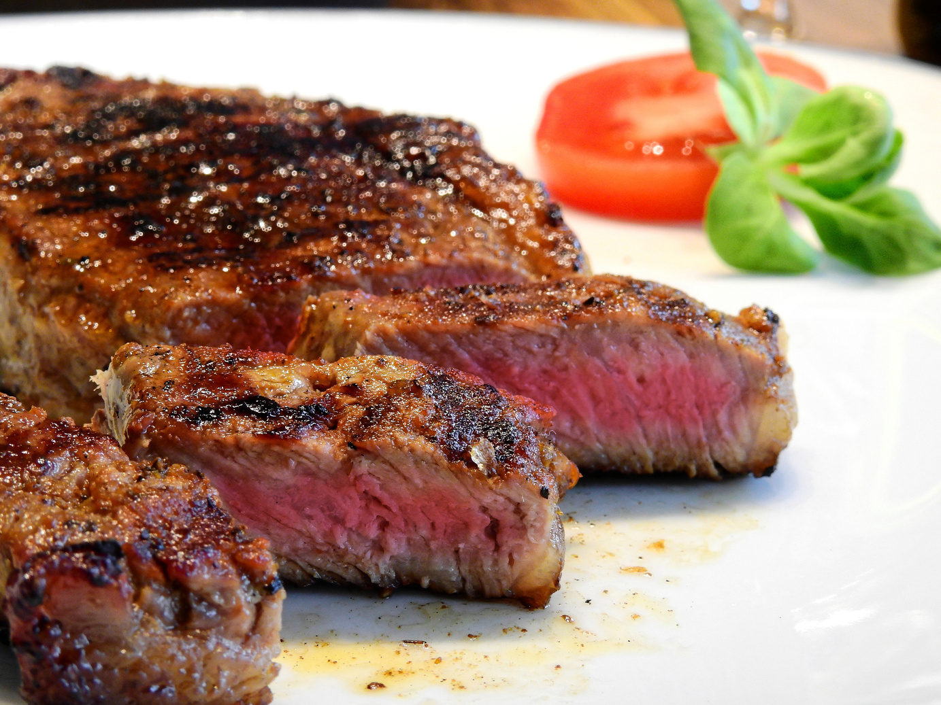
Our Vision &
Mission
Why This Website?
• The growing importance of online presence for restaurants
• The need for easy-to-use, efficient, and visually appealing platforms
• Our goal: Enhance customer experience and restaurant management
Who Benefits from This?
• Restaurant owners looking for better management
• Customers seeking convenience and customization
• VIP clients enjoying exclusive services

Slide 4
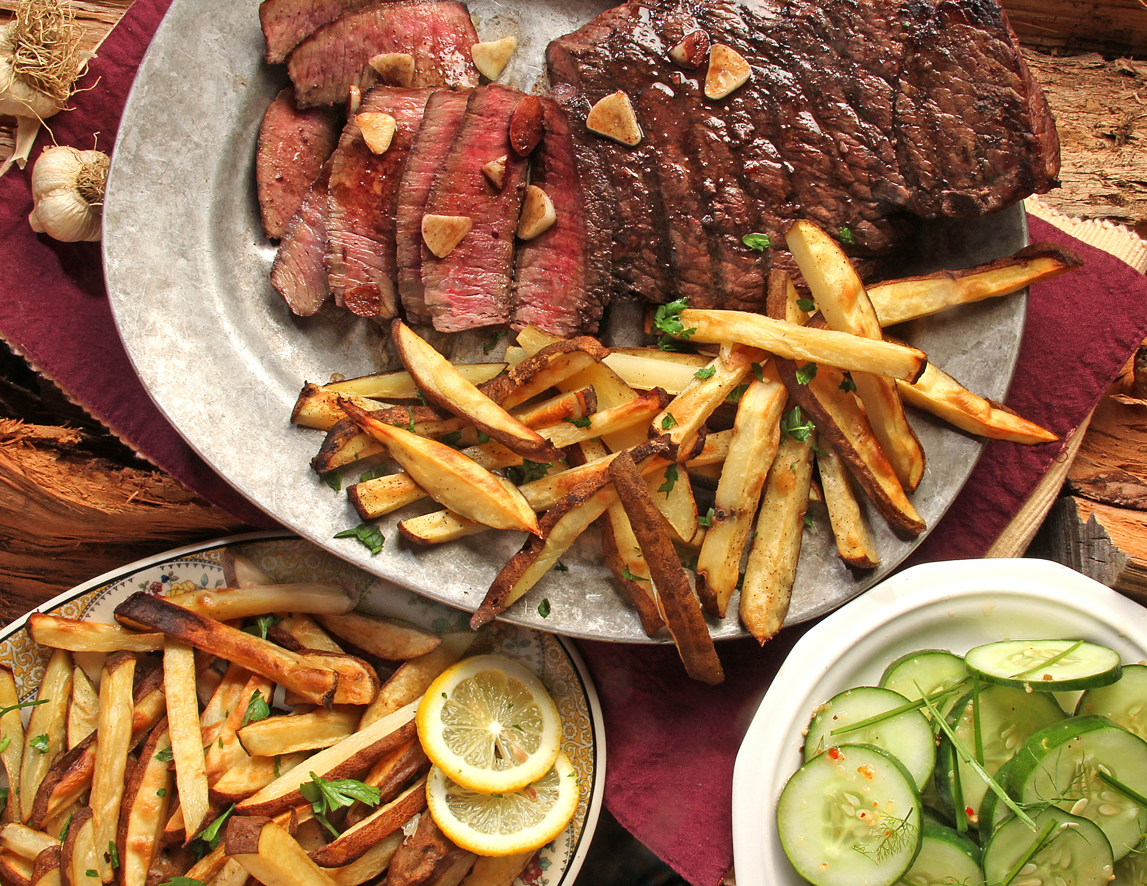
Key Feature of
Functional Requirement
TTT
Login / Register
Account Management
Browsing Products
Ordering Process
Payment Integration
Order Tracking:

Slide 5
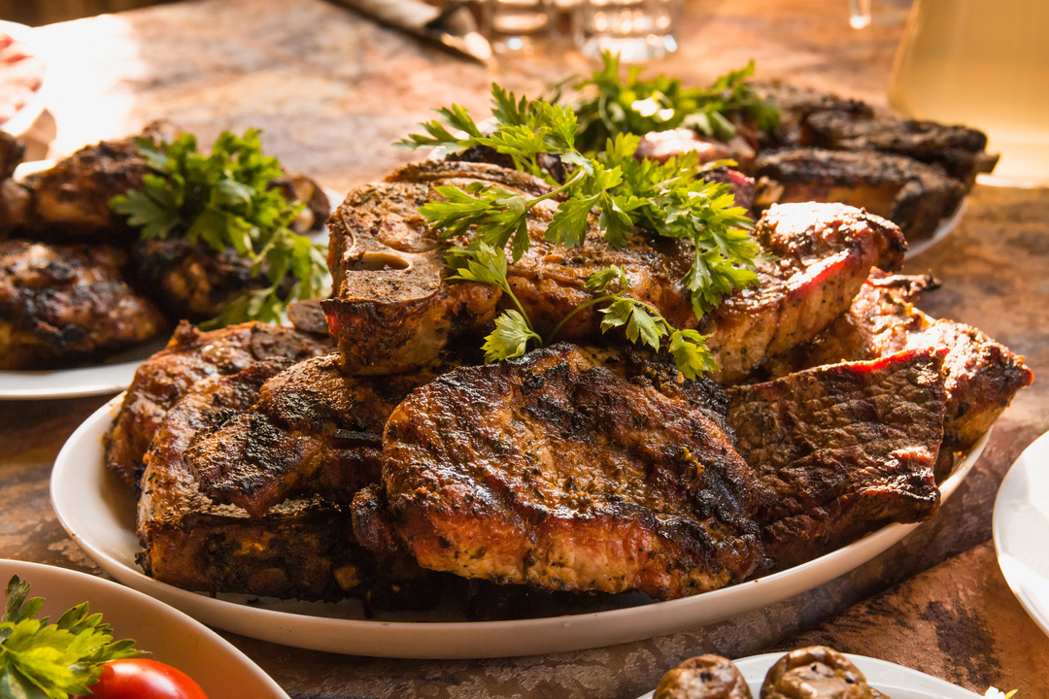
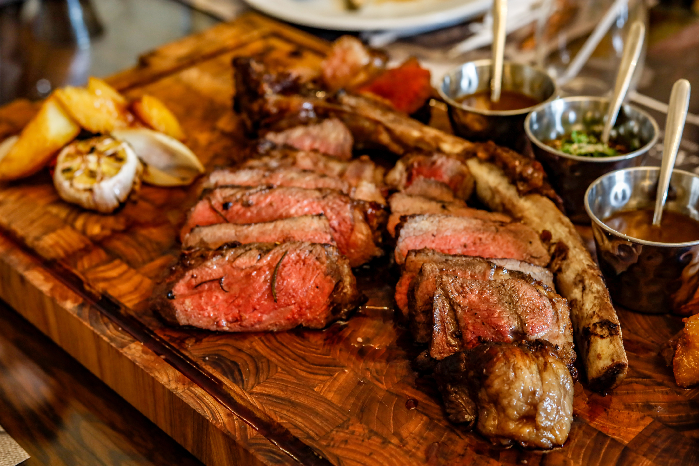
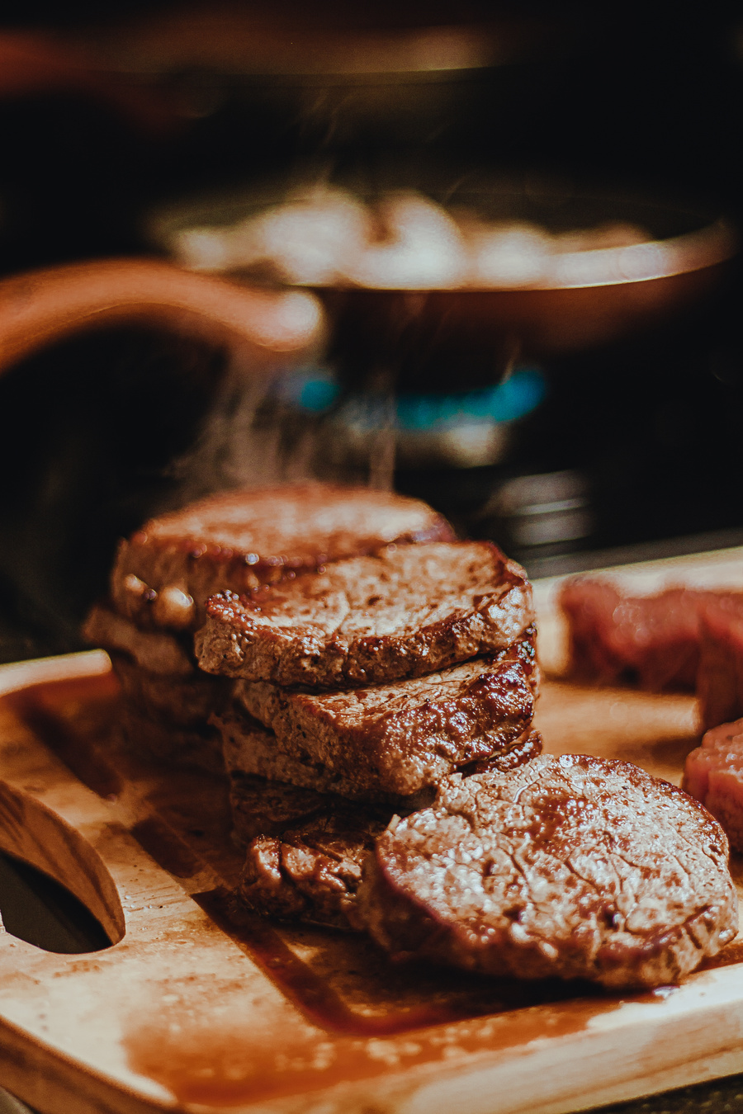
User-Centered
Design
01
Simple navigation for customers
02
Responsive design for mobile and desktop
03
•Accessibility for diverse user needs

Slide 6
Build with
Modern Tools
01
• Frontend: React.js, Node.js, Html, Css
02
• Backend: Node.js
03
• Database: MySQL

Slide 7
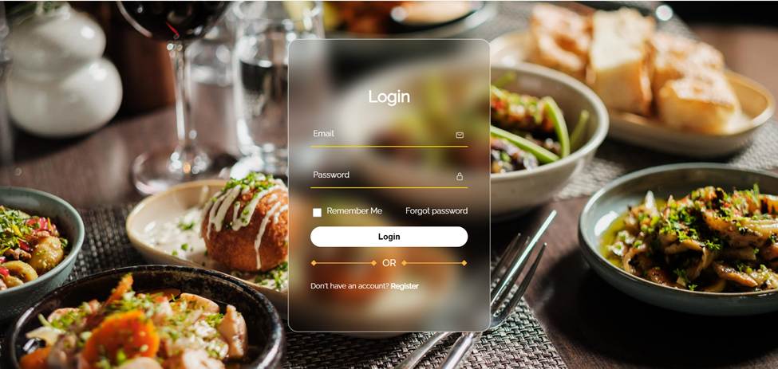
Register/Login Page

Slide 8
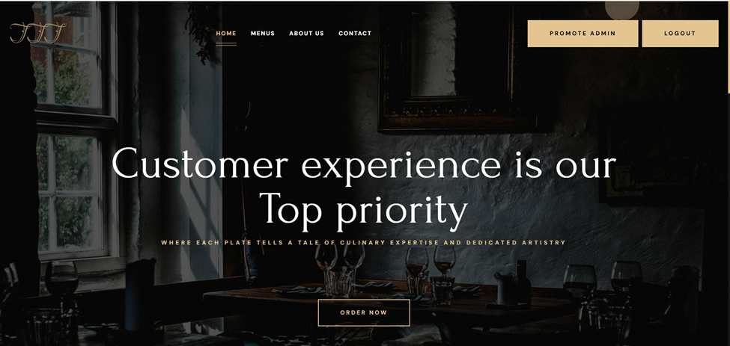
Hero Page

Slide 9
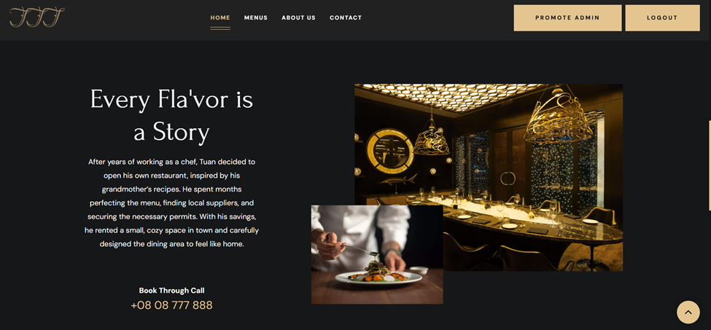
About Us Page

Slide 10
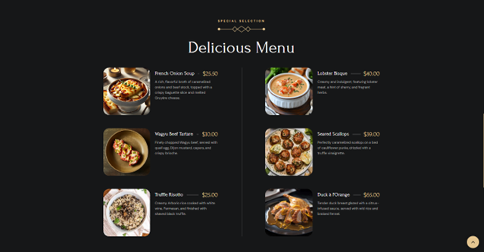
Menu Page

Slide 11

Demo

Slide 12
Thank You

